Slide 1

Alarming System for Natural Gas Consuming
EE4211 Data Science for IoT
Final Project Presentation
—— Student Proposal
Team Name
Big Three
Team Member
Gu Jiapan
Xin Yuhui
Wang An

Slide 2
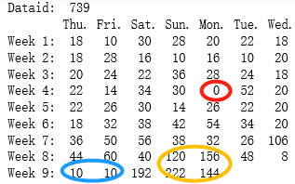
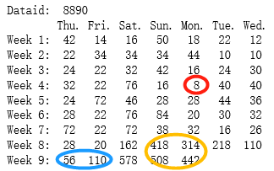
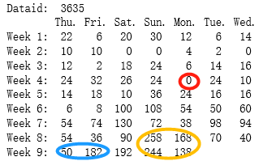
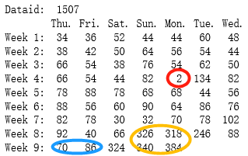
Daily gas consumption for each home
Valley
Turning point
Peak

Slide 3
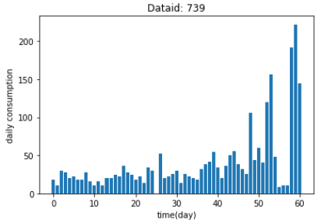
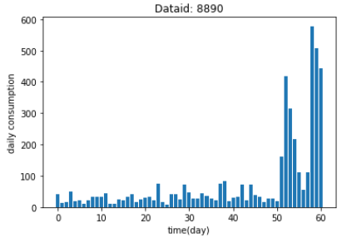
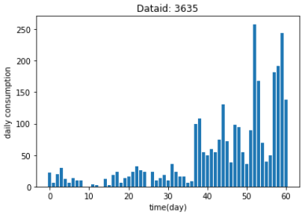
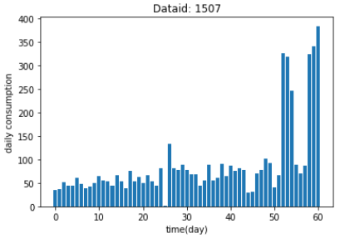
Daily gas consumption for each home

Slide 4
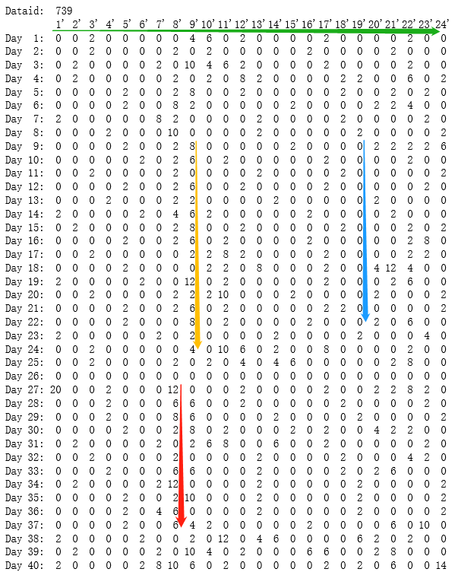
Hourly gas consumption
Horizontal perspective:
Hourly values on a specific day
Vertical perspective:
Values of a specific hour for several days

Slide 5
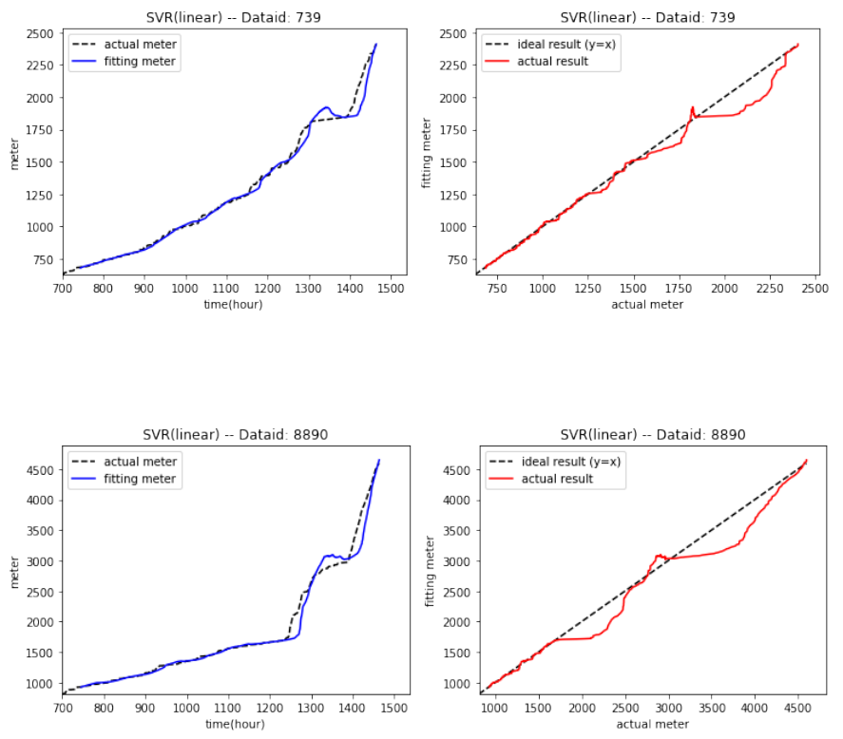
Hourly reading
in “Forecasting” part
Actual vs Predicted

Slide 6
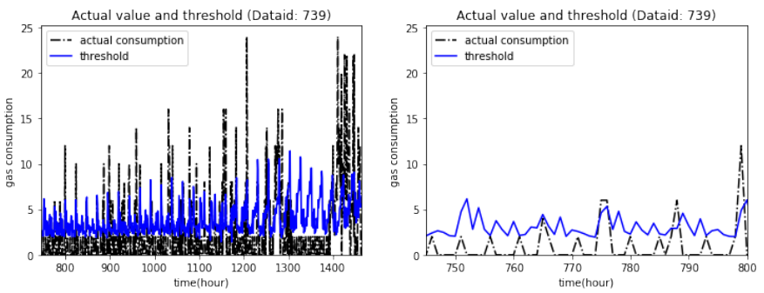
Actual consumption vs Threshold
= Vertically predicted value + Bias
Approximately periodic but dynamically changing
magnify

Slide 7
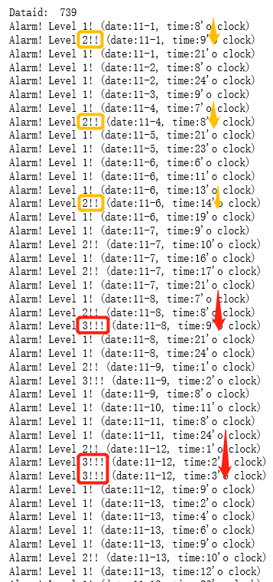
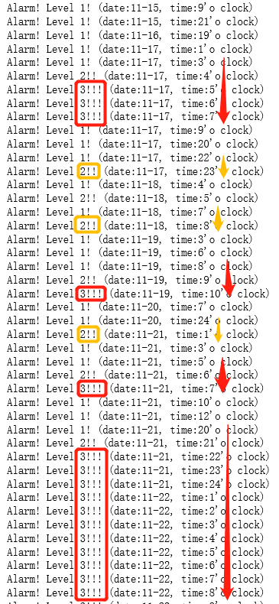
Graduation alarming method
Level 1:
The first time exceeding
Level 2:
Two consecutive hours
Level 3:
Last longer

